Slide 1
The Empire Strikes Back – Azure DocumentDB
David Green DevTeach July, 2016

Slide 2

About Me
I currently live in Raleigh, North Carolina with my wife and three kids.
Developer for 15+ years in the MSFT stack (C#, ASP.NET MVC, SQL Server, and etc.)
I like NoSQL and Machine Learning these days.
Organizer for Raleigh Code Camp and speaker chair Monthly Triangle .NET Meetup Group.
I like all things Star Wars.

Slide 3

Agenda
Azure, NoSQL, and DocumentDB
Getting up and Running in Azure
Exploring DocumentDB (Query Explorer)
Working with DocumentDB (C#)
Interesting Features
Final Remarks

Slide 4
A long time ago in a galaxy far, far away…
(Redmond, WA ~ August 2014)

Slide 5
Product Name: | Azure DocumentDB
Pronunciation: | azh-er dok-uh-muh nt dee bee
Definition: | A fully managed, highly scalable NOSQL document database service

Slide 6
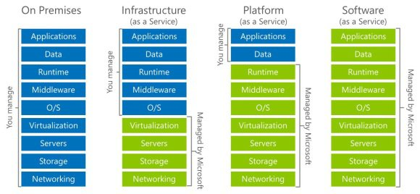
A fully managed, highly scalable NOSQL document database service
You are here

Slide 7

A fully managed, highly scalable NOSQL document database service
DocumentDB
Vertical Scaling
Horizontally Scaling (partition tolerance)
More RAM, faster CPU, etc.
More Low Cost (commodity) VMs.
And etc.

Slide 8
What is NoSQL?
A fully managed, highly scalable NOSQL document database service
Martin Fowler: Some characteristics are common amongst these databases, but none are definitional.
Redis
Riak
Memcached
CouchDB
RavenDB
Model not using the SQL language
Designed to run on large clusters
Not using the relational model
Hbase
Cassandra
Hypertable
Neo4J
GiraffeDB
InfiniteGraph
No schema enforced
Open source

Slide 9
NoSQL DATABASE FAMILIES
A fully managed, highly scalable NOSQL document database service
Key-Value
Document
Redis
Riak
Memcached
MongoDB
RavenDB
DocumentDB
Columnar
Graph
Hbase
Cassandra
Hypertable
Neo4J
GiraffeDB
InfiniteGraph

Slide 10
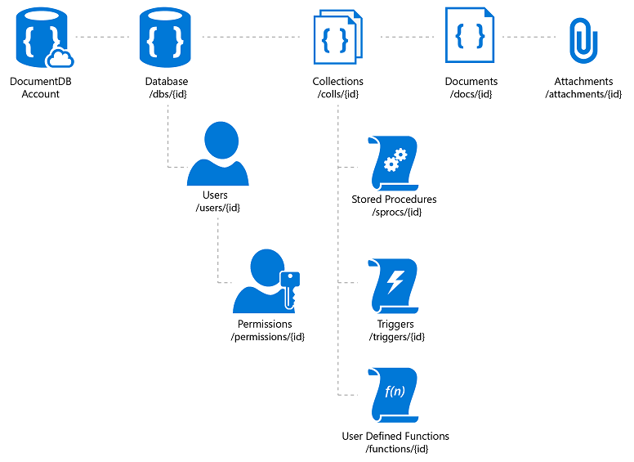
DocumentDB in One Slide
Simple HTTP RESTful model.
All resources are uniquely addressable by a URI.
Access can be via any client that supports HTTP. Libraries for; Node, .NET, Python, JS .
Partitioned for scale out and replicated for HA. Tunable indexing & consistency.
Granular access control through item level permissions
Attachments stored in Azure Blobs and support document lifecycle.
T-SQL like programmability.
Customers buy storage and throughput capacity basis at account level.

Slide 11
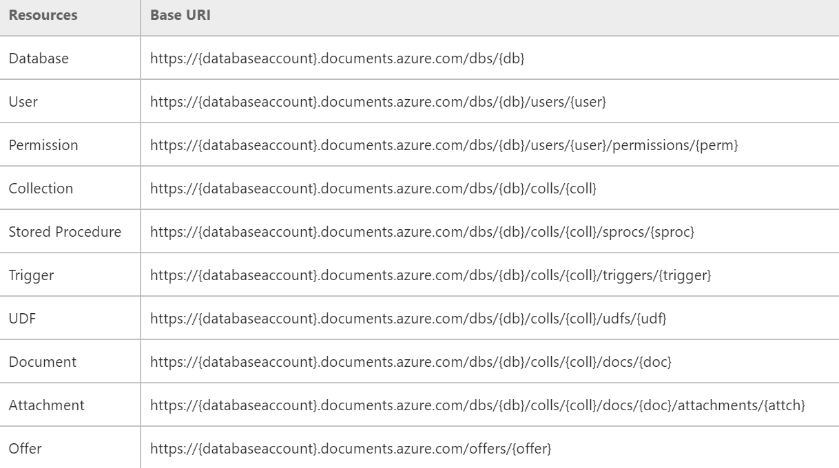
DocumentDB Resource URI Syntax for REST
Notes:
Stored in the _self attribute metadata property of the document.

Slide 12
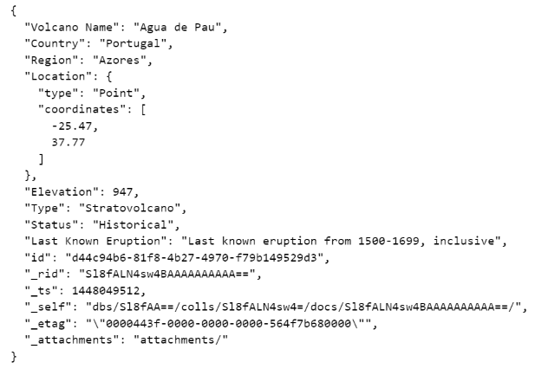
SAMPLE Document DB Document

Slide 13
USE CASES (Technical PERSPECTIVE)
General Principle 1
Know your use case. Do not force fit a technology for a problem. Rather, choose the technology that best aligns with solving your problem.
General Principle 2
Figure out the operation(s) you do the most and optimize for those cases. If you have an existing product, gather metrics about current usage patterns (e.g. reads/writes per second) to help guide you.
Notes:
You can just about make a relational database do anything, but the question is do you want to? The same applies with DocumentDB. That said, 1) Avoid using in situations where you must maintain several complex non-hierarchical relationships in your data. 2) You require server programmability (UDF, Stored Procs, etc.) but you are not comfortable with JavaScript (or your talent is strong with T-SQL)

Slide 14
USE CASES (BUSINESS PERSPECTIVE)
Document Management systems
E-commerce (catalog portion only)
Archiving/event logging
Gaming
Mobile
Real time analytics (based on logging)
Notes:
https://azure.microsoft.com/en-us/documentation/articles/documentdb-use-cases/

Slide 15
Who USES THIS CURRRENTLY?
Next Games. The Walking Dead: No Man's Land game soars to #1 supported by Azure DocumentDB.
Halo. How Halo 5 implemented social gameplay using Azure DocumentDB.
Cortana Analytics Gallery. Cortana Analytics Gallery - a scalable community site built on Azure DocumentDB.
Breeze. Leading Integrator Gives Multinational Firms Global Insight in Minutes with Flexible Cloud Technologies.
News Republic. Adding intelligence to the news to provide information with purpose for engaged citizens.
SGS International. For consistent color across the globe, major brands turn to SGS. And SGS turns to Azure.
Telenor. Global leader Telenor uses the cloud to move with the speed of a startup.
XOMNI. The store of the future runs on speedy search and the easy flow of data.
Notes:
Use cases: https://azure.microsoft.com/en-us/documentation/articles/documentdb-use-cases/
Also MSFT was “dog feeding” with Microsoft Band, Xbox, MSN before going live.

Slide 16

Agenda
Azure, NoSQL, and DocumentDB
Getting up and Running in Azure
Exploring DocumentDB (Query Explorer)
Working with DocumentDB (C#)
Interesting Features
Final Remarks
“Ben…” – Luke Skywalker

Slide 17
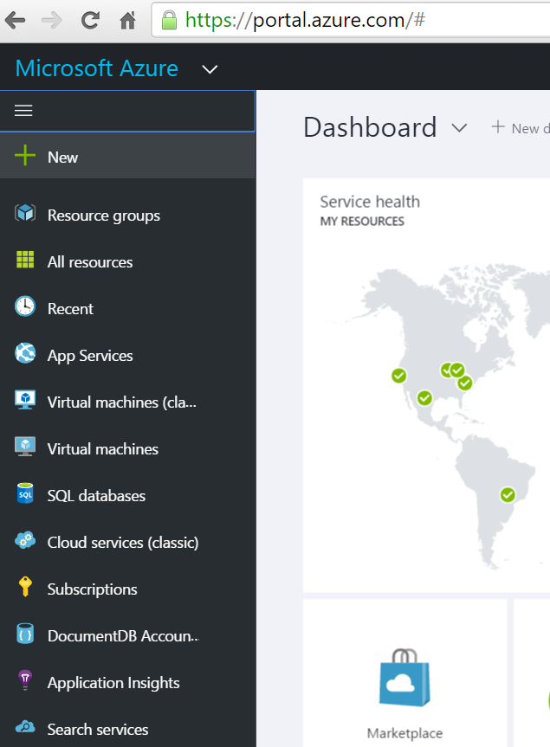
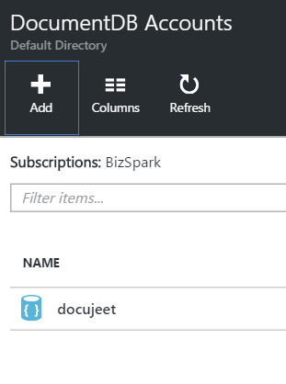
Getting Started

Slide 18
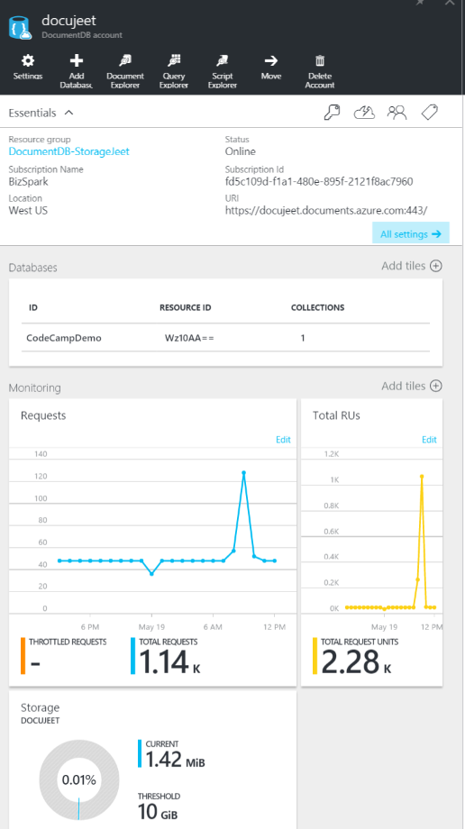
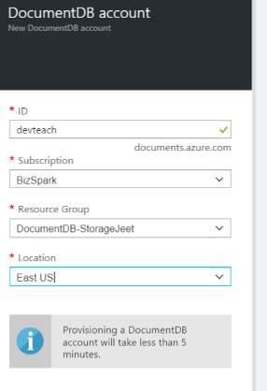
Getting Started (CONT’D)

Slide 19
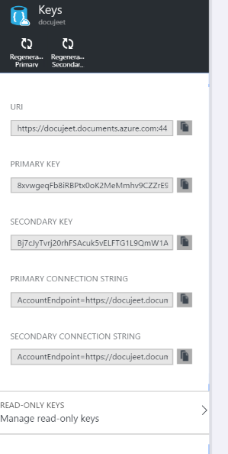
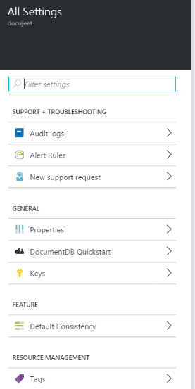
Getting Your KEYS

Slide 20

Agenda
Azure, NoSQL, and DocumentDB
Getting up and Running in Azure
Exploring DocumentDB (Query Explorer)
Developing with DocumentDB (C#)
Interesting Features
Final Remarks
“You must unlearn what you have learned” – Yoda

Slide 21
When you say…IN DocumentDB IT’s LIKE…
SQL Term | DocumentDB Term
database | database
table | collection
index | index
row | document
column | field
table joins | embedding & linking
primary key | id

Slide 22
QUERYING (NO DATA)
-- Basic expressions
SELECT "Hello"
SELECT VALUE "Hello"
SELECT { "word1": "Hello", "word2": "World" } as words
-- Operator Query
SELECT
15 * ((2 + 11 % 7) - 2) / 2 AS Math1,
15 * ((2 + 11 % 7) - 2) / 2.1 AS Math2,
("hot" = "cold" AND "up" = "down" OR 1 = 1) AS Logical1,
("hot" = "cold" AND ("up" = "down" OR 1 = 1)) AS Logical2,
(2 > 3 ? "higher" : "lower or equal") AS Ternary,
(undefined ?? undefined ?? "third") AS Coalesce1,
(undefined ?? "second" ?? "third") AS Coalesce2,
("first" ?? undefined ?? "third") AS Coalesce3,
"Hello" || " " || "World" AS StringConcat
-- Math Query
SELECT
ROUND(3.4) AS MathRound1,
ROUND(3.5) AS MathRound2,
CEILING(3.4) AS MathCeiling1,
CEILING(3.5) AS MathCeiling2,
FLOOR(3.4) AS MathFloor1,
FLOOR(3.5) AS MathFloor2,
ABS(-5) AS MathAbs1,
ABS(5) AS MathAbs2,
SIN(28) AS MathSin,
COS(28) AS MathCos,
TAN(28) AS MathTan,
LOG(16) AS MathLog,
PI() AS MathPi

Slide 23
SAMPLE DATA
https://azure.microsoft.com/en-us/documentation/articles/documentdb-import-data/
The DocumentDB Data Migration tool is an open source solution that imports data to DocumentDB from a variety of sources, including:
JSON files
MongoDB
SQL Server
CSV files
Azure Table storage
Amazon DynamoDB
HBase
DocumentDB collections
Azure DocumentDB Data Migration Tool
Download
Github: https://github.com/azure/azure-documentdb-datamigrationtool
Microsoft: https://www.microsoft.com/en-us/download/details.aspx?id=46436
Notes:
I took some data from AdventureWorks 2014: http://msftdbprodsamples.codeplex.com/

Slide 24
QUERIES (WITH Data)
SELECT VALUE c.name FROM c -- Get all names as a flat string array SELECT VALUE c.name FROM c WHERE c.name >= 'B' AND c.name < 'D' ORDER BY c.name DESC -- Range query
SELECT * FROM c.address AS l WHERE l.stateProvinceName IN ('Florida', 'Illinois') -- Alias the subset to filter within subset
SELECT c.name, c.address.countryRegionName AS region, (c.address.countryRegionName = "United States" ? "USD" : "CAD") AS currency FROM c WHERE c.address.countryRegionName IN ("United States", "Canada") -- ternary operator

Slide 25

Agenda
Azure, NoSQL, and DocumentDB
Getting up and Running in Azure
Exploring DocumentDB (Query Explorer)
Developing with DocumentDB (C#)
Interesting Features
Final Remarks
“Sorry…” – Lando Calrissian

Slide 26
Demos
Hello World-ish Example (C#)
Sample App (ASP.NET MVC 5, C#)
Notes:
All of the examples work but do not take advantage of the newest improvements in the Azure C# SDK client, namely ID-based routing https://www.pluralsight.com/courses/azure-documentdb-introduction (last module). Could save you a few lines of code, much cleaner.

Slide 27

Agenda
Azure, NoSQL, and DocumentDB
Getting up and Running in Azure
Exploring DocumentDB (Query Explorer)
Developing with DocumentDB (C#)
Interesting Features
Final Remarks

Slide 28

Indexing
By default all columns are indexed.
Indexes are schema free
Three types of indexes:
Hash index (SELECT * FROM collection c WHERE c.prop = ‘Jared’)
Range index (SELECT * FROM collection c WHERE c.prop > 5)
Spatial
Three indexing modes:
Consistent
Lazy
None
Notes:
Good source: https://azure.microsoft.com/en-us/documentation/articles/documentdb-indexing-policies/ * Range indexes are the default
Consistent: If a DocumentDB collection’s policy is designated as "consistent", the queries on a given DocumentDB collection follow the same consistency level as specified for the point-reads (i.e. strong, bounded-staleness, session or eventual). The index is updated synchronously as part of the document update (i.e. insert, replace, update, and delete of a document in a DocumentDB collection).
Lazy: To allow maximum document ingestion throughput, a DocumentDB collection can be configured with lazy consistency; meaning queries are eventually consistent. The index is updated asynchronously when a DocumentDB collection is quiescent i.e. when the collection’s throughput capacity is not fully utilized to serve user requests. For "ingest now, query later" workloads requiring unhindered document ingestion, "lazy" indexing mode may be suitable.
DocumentDB also supports the Spatial index kind for every path, that can be specified for the Point data type. The value at the specified path must be a valid GeoJSON point like {"type": "Point", "coordinates": [0.0, 10.0]}.
Spatial supports efficient spatial (within and distance) queries.

Slide 29

Attachments
Store large blobs/media outside core storage
Document DB managed
Submit raw content in POST
Document DB stores into Azure Blob storage
Document DB manages lifecycle
Create Attachment providing URL to content

Slide 30
Stored Procedures, Triggers, UDF
JavaScript as T-SQL
Transactional
Each call to the service is in ACID transaction
Uncaught exception to rollback
Sandboxed
No imports
No network calls
No Eval()
var helloWorldStoredProc = {
id: "helloRealWorld",
body: function () {
var context = getContext();
var response = context.getResponse();
response.setBody("Hello, DevTeach 2016");
response.setBody("How are you?");
}
}

Slide 31
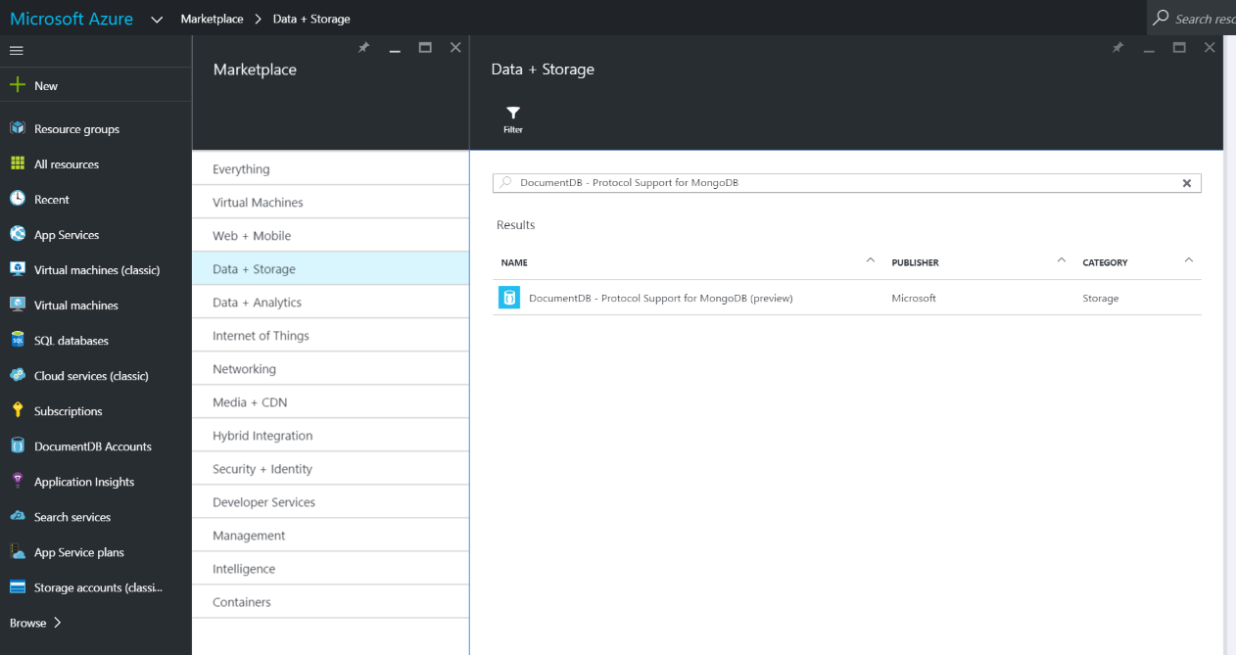
MongoDB DRIVER Integration
Notes:
At the moment only basic CRUD operations are supported. More complex aggregations could be in the future though if there is sufficient demand.

Slide 32

Agenda
Azure, NoSQL, and DocumentDB
Getting up and Running in Azure
Exploring DocumentDB (Query Explorer)
Developing with DocumentDB (C#)
Interesting Features
Final Remarks
“You do have your moments…not many of them, but you do have them” – Princess Leia

Slide 33

TUNABILITY
As a function of being a PAAS solution, DocumentDB horizontally scales in these three main areas:
Storage
Throughput
Consistency

Slide 34
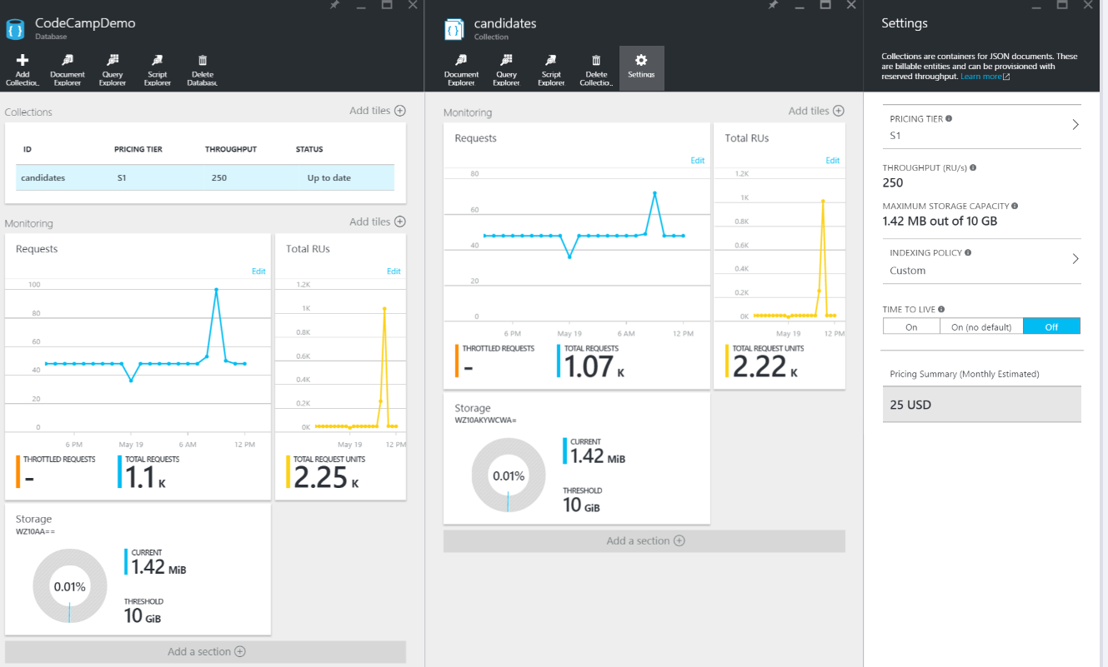
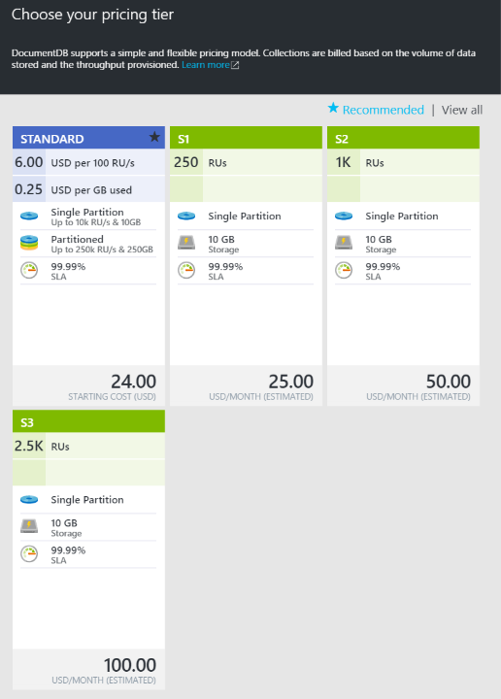
Scaling (PER COLLECTION)
Notes:
Billing is per collection! Imagine if we were charged by the table in SQL Server?!! But see how it forces you to consider a tall, narrow schema instead of a wide schema

Slide 35
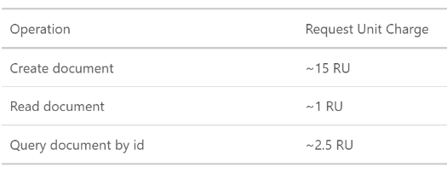
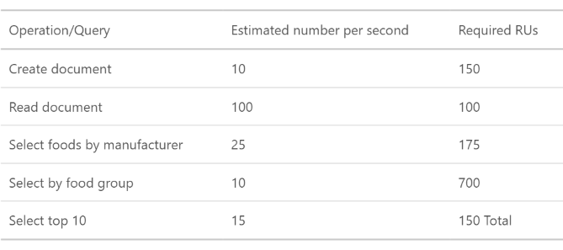
Request Unit Charges
With an example 1KB document, and consistency level of “Session”:

Slide 36
Consistency
Four consistency levels
STRONG – all writes are visible to all readers. Writes committed by a majority quorum of replicas and reads are acknowledged by the majority read quorum.
BOUNDED STALENESS – guaranteed ordering of writes, reads adhere to minimum freshness. Writes are propagated asynchronously, reads are acknowledged by majority quorum lagging writes by at most N seconds or operations (configurable).
SESSION (Default) – read your own writes. Writes are propagated asynchronously while reads for a session are issued against the single replica that can serve the requested version.
EVENTUAL – reads eventually converge with writes. Writes are propagated asynchronously while reads can be acknowledged by any replica. Readers may view older data then previously observed.

Slide 37
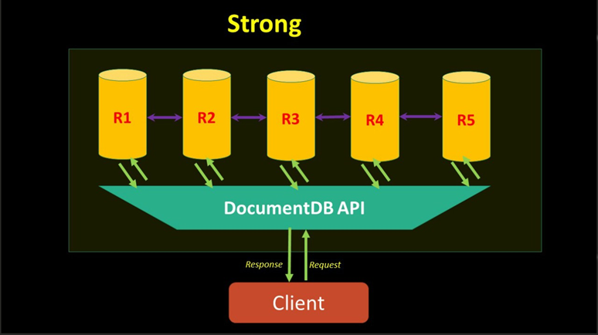
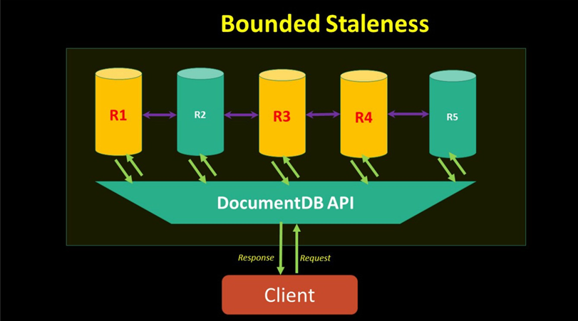
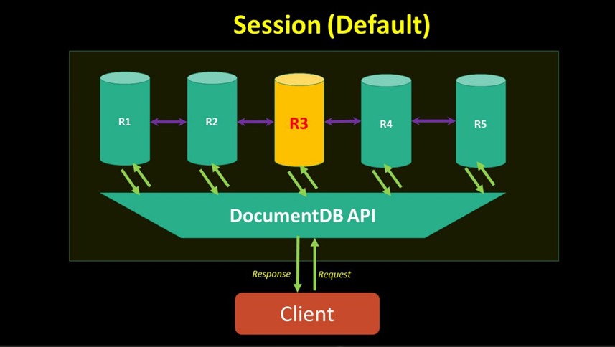
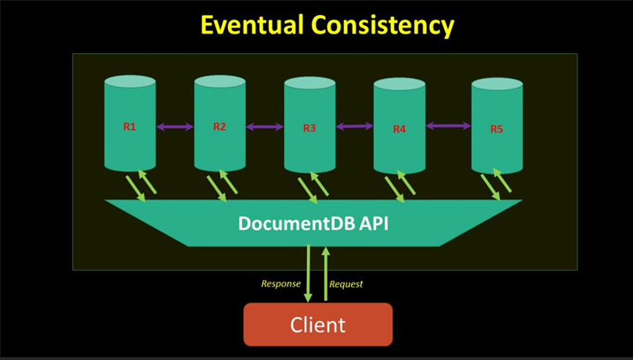
Consistency

Slide 38
Resources
Documentation https://azure.microsoft.com/en-us/documentation/services/documentdb/
Improving DocumentDB https://feedback.azure.com/forums/263030-documentdb
Video Tutorials Pluralsight: Introduction to Azure DocumentDB (Leonard Lobel)

Slide 39


Questions?
Twitter: @davidjeet
Blog: endgameanalytics.com
LinkedIn: www.linkedin.com/in/nosqlguy
GitHub: github.com/davidjeet
LA FIN

